Slide 1
Introduction of the Indiana (IN) Health Equity Council (HEC) Community Health Worker (CHW) Model
Presented by:

Slide 2
Goal
Through the Indiana Health Equity Council CHW Model:
Identify and address state district needs, foster communication, synergy, and ultimately, evaluate and demonstrate the effectiveness and impact of CHW-led statewide COVID-19 vaccine hesitancy and related social determinants of health efforts among Indiana health disparity populations.
We are here to come alongside existing organizations.

Slide 3
IN HEC CHW MODEL
Justification – Why this Model?

Slide 4
The IN HEC CHW Model is used for this project because CHWs are community influencers who can:
Convene
Convene invested CHW organizations and individuals and bring them to the table
Gather and share
Gather and share COVID resources and other resources. These resources will be shared among other CHW organizations and coalition.
Share
Share the HEC CHW project and goals to the community.
Participate in
Participate in meetings and/or data collecting.
Share
Share concern/needs of community

Slide 5
The CHW Model focus on these areas because:
COVID-19 disproportionately affects racial and ethnic minority groups in the US^{1,2}
Blacks and Hispanics are 2.3 and 2.0 times more likely to be hospitalized for COVID-19 respectively³
These populations are 2 times more likely to die of COVID-19 after hospitalization³
Variability in social determinants of health (SDOH) contribute to poor health outcomes in these communities⁴
There is need to strategically address the COVID-19-related SDOH and reduce vaccine hesitancy among health disparity populations

Slide 6
What are Social determinants of health (SDOH)?
Social determinants of health (SDOH) are the conditions in the environments
where people are born, live, learn, work, play, worship, and age that affect a
wide range of health, functioning, and quality-of-life outcomes and risks.
~ Healthy People 2030
SDOHs are accountable for most health disparities, which are the unfair and avoidable differences in health status seen within and between countries.
~World Health Organization (WHO)
There are 5 SDOH Domains
Notes:
US Department of Health and Human Services. Healthy People 2030. Social Determinants of Health. Social Determinants of Health - Healthy People 2030 | health.gov . Accessed November 21st, 2022.
World Health organization. Social determinants of Health : Key Concepts. Social determinants of health: Key concepts (who.int). Accessed on November 21st, 2022.

Slide 7
IN HEC CHW MODEL: COVID-19 & SDOH Focus Areas
COVID-19: Understand and respond to vaccine hesitancy, convenience and education to help the community mitigate risks of exposure to COVID-19.
Those with low health literacy and from a disadvantaged population are more likely to have poorer COVID-19-related health outcomes.
Many Hispanics and Blacks are less likely to have quality health insurance and those with low incomes (including those facing homelessness and food insecurity) also tend to have limited access to care.
A strong relationship exists between socioeconomic status and cardiovascular diseases (CVD) and increases the risk of sickness and death due to COVID-19.
Notes:
1. US Department of Health & Human Service. Social cohesion. In: Healthy People 2020. Washington, DC: U.S. Department of Health and Human Services (2020).
2. Singu S, Acharya A, Challagundla K and Byrareddy SN (2020) Impact of Social Determinants of Health on the Emerging COVID-19 Pandemic in the United States. Front. Public Health 8:406. doi: 10.3389/fpubh.2020.00406
3. Mackenbach JP, Cavelaars AE, Kunst AE, Groenhof F. Socioeconomic inequalities in cardiovascular disease mortality; an international study. Eur Heart J. (2000) 21:1141–51. doi: 10.1053/euhj.1999.1990

Slide 8
Health Disparity Population Focus Areas
According to the NIH (National Institutes of Health), populations that experience health disparities include:
Racial and ethnic minority groups.
People with lower socioeconomic status (SES).
Underserved rural communities.
Sexual and gender minority (SGM) groups.

Slide 9
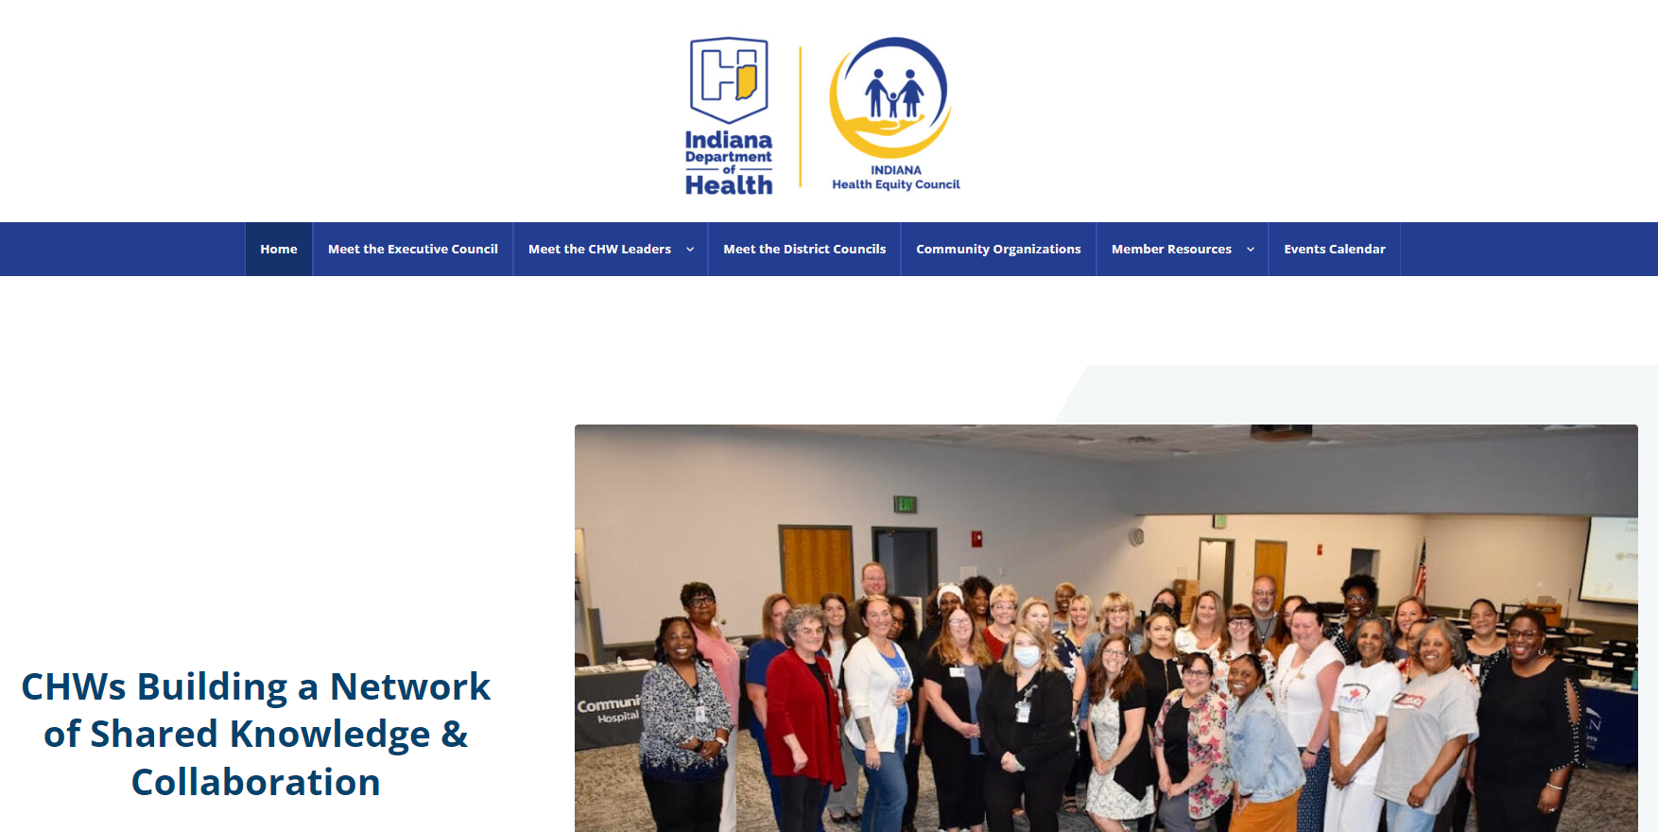
IN HEC-CHW MODEL
Website - https://inhealthequitycouncil.com/

Slide 10
What does the IN HEC CHW Model Look Like?

Slide 11
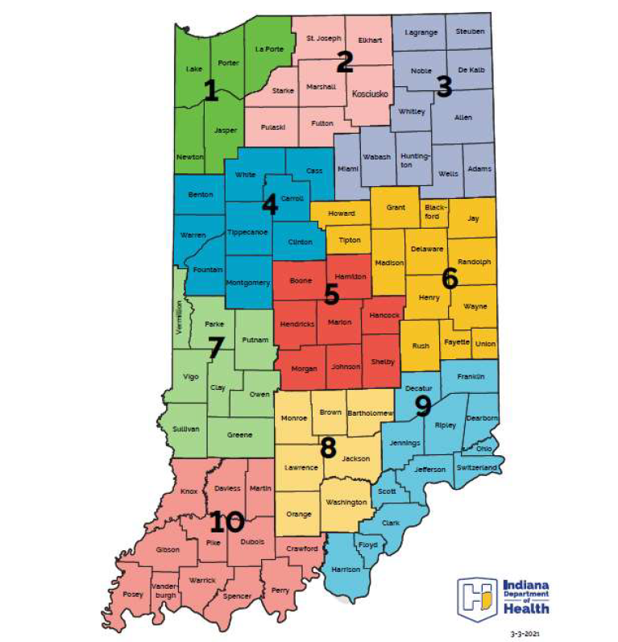
IN-HEC CHW Model Building a network of shared knowledge and collaboration
This model involves having at least 1 District Health Equity Council CHW in each of the 10 Public Health Preparedness Districts in Indiana.
For the purpose of better preparing the state for the next public health emergency
A Community Health Worker (CHW) is a frontline public health worker who is a trusted member of and/or has an unusually close understanding of the community served. This trusting relationship enables the CHW to serve as a liaison/link/intermediary between health/social services and the community to facilitate access to services and improve the quality and cultural competence of service delivery.
A community health worker also builds individual and community capacity by increasing health knowledge and self-sufficiency through a range of activities such as outreach, community education, informal counseling, social support, and advocacy.

Slide 12
District Health Equity Council (HEC) Example
CHW serving
Native American
Community
District #
HEC CHW
CHW serving
Disabled Community
LHD/FQHC
CHW serving
Burmese/Chin Community
CHW serving
African American
Community
CHW serving
Hispanic Community
CHW serving
Amish Community
We are opening lines of communication among partners to bring down silos.
Notes:
CHWs or Community Influencers will be from local CBOs or coalitions.
District HEC allotted a community engagement amount that will help address the unique needs of their community
HEC will be convened to identify current CBO CHW-led health equity efforts and needs of that county or district.
District Health Equity CHW will work with District HEC and CHW to standardize data collection in order to evaluate impact of efforts within and across District HECs

Slide 13
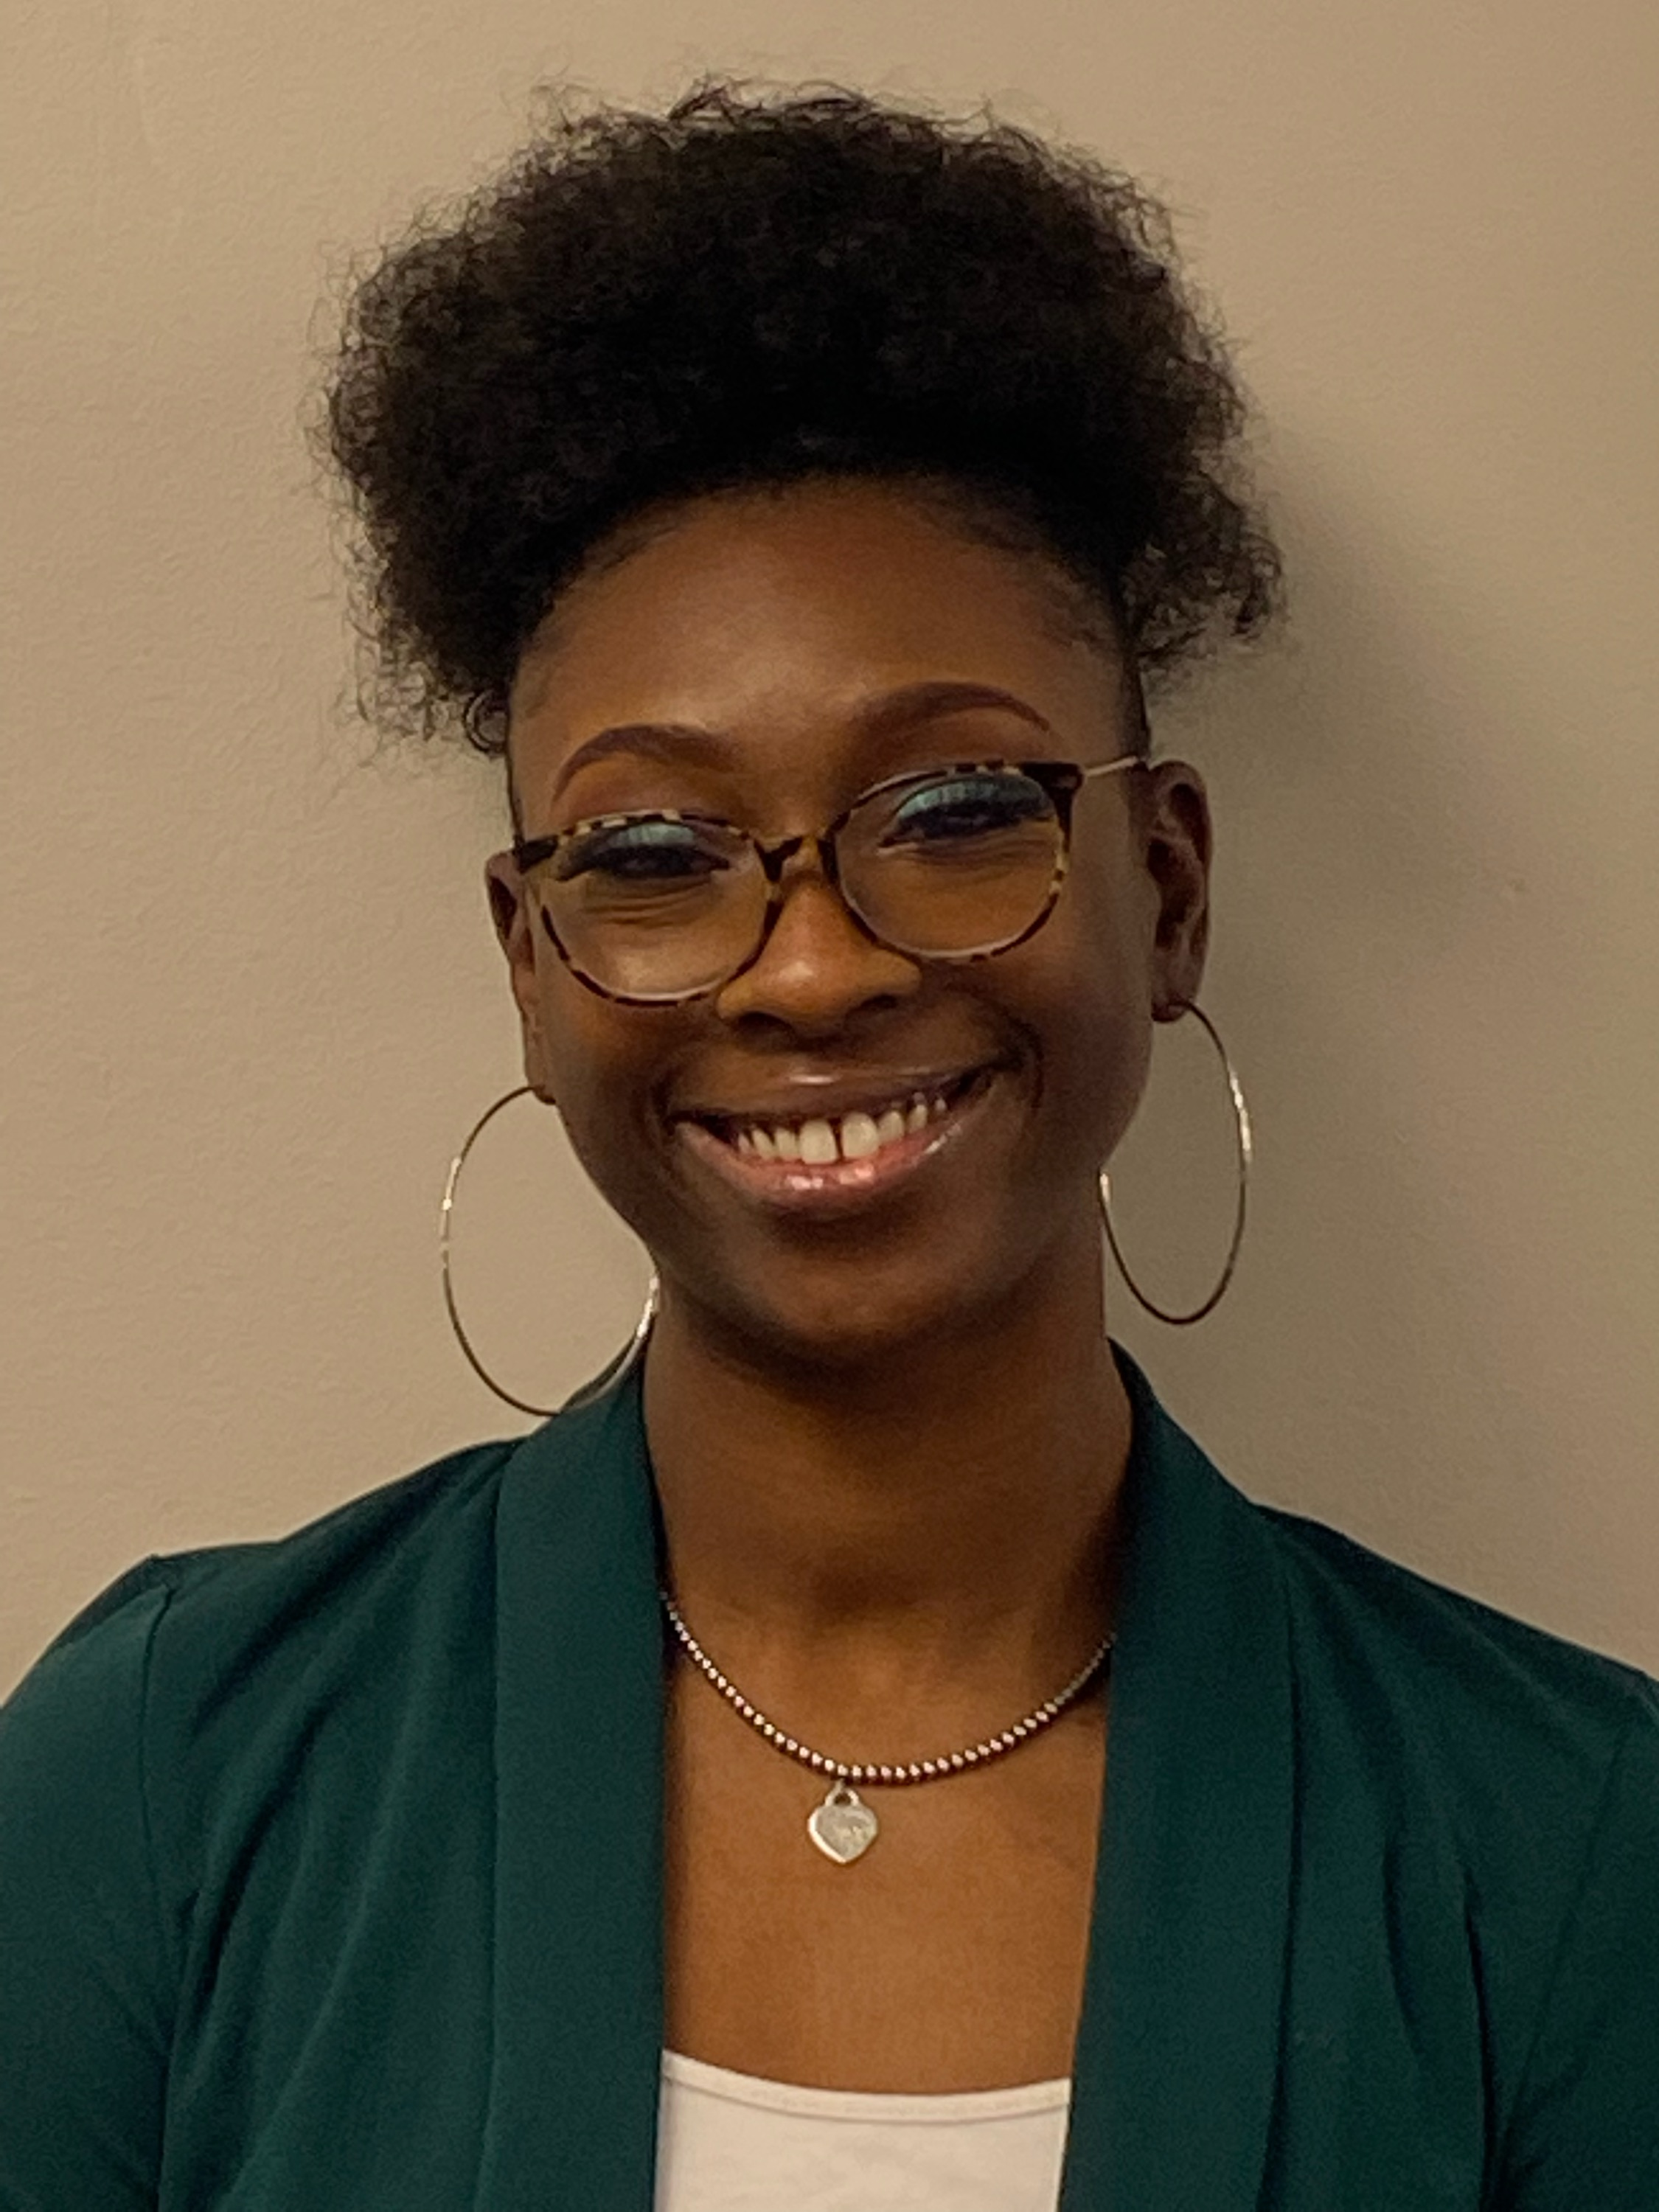
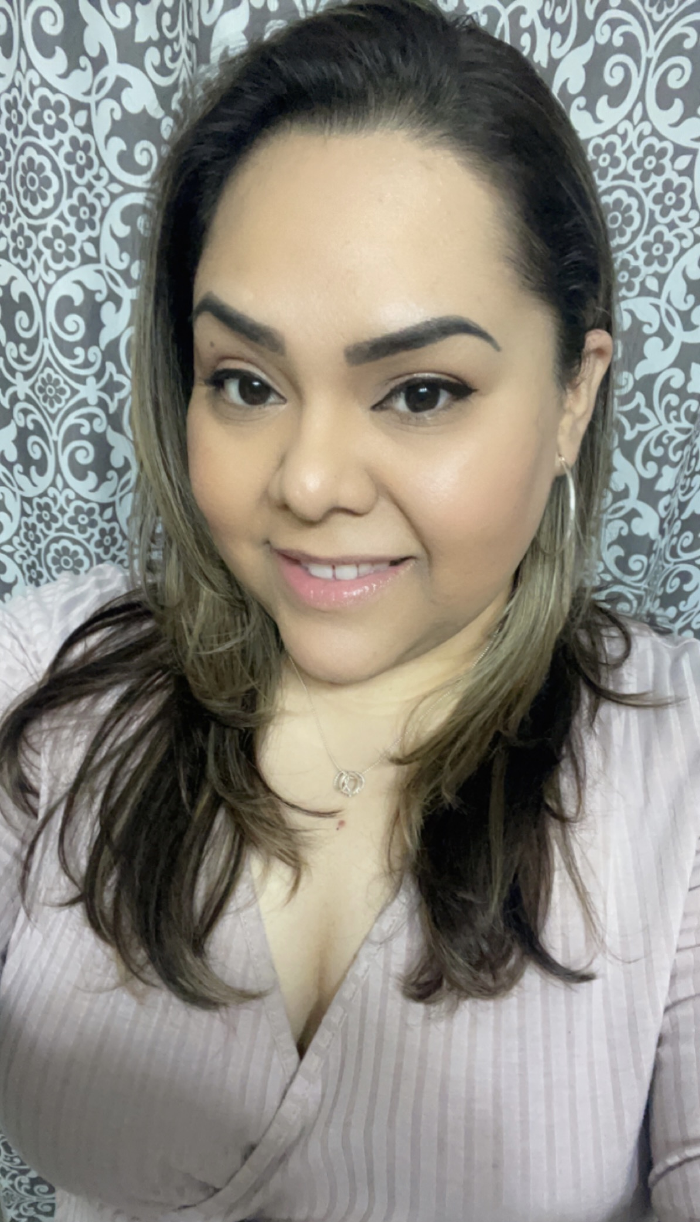
We are your District HEC CCHW We are a resource for our partners.
CHW Engagement Coordinator
Shamika Crowder
scrowder@health.in.gov
Karina Buenavides
Kbuenavides@health.in.gov
Lake, Porter, Laporte, Newton, and Jasper
District 1
Celeste Fonseca-Tames
CFonsecaTames@health.in.gov
St. Joseph, Elkhart, Starke, Marshall, Kosklusko, Pulaski, Fulton
District 2

Slide 14
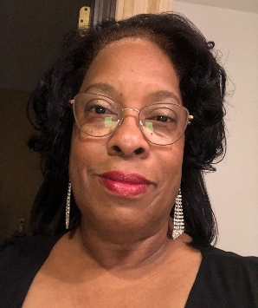
We are your District HEC CCHW We are a resource for our partners.
Carliss Harrison
charrison1@health.in.gov
Adams, Allen, DeKalb, Huntington, LaGrange, Miami, Noble, Steuben, Wabash, Wells, Whitley
District 3
Latrice Ligon
Lligon@health.in.gov
Benton, White, Cass, Carroll, Warren, Tippecanoe, Clinton, Fountain, Montgomery
District 4
Lance Boozer
Lboozer@health.in.gov
Boone, Hamilton, Hendricks, Marion, Hancock, Morgan, Johnson, Shelby
District 5

Slide 15
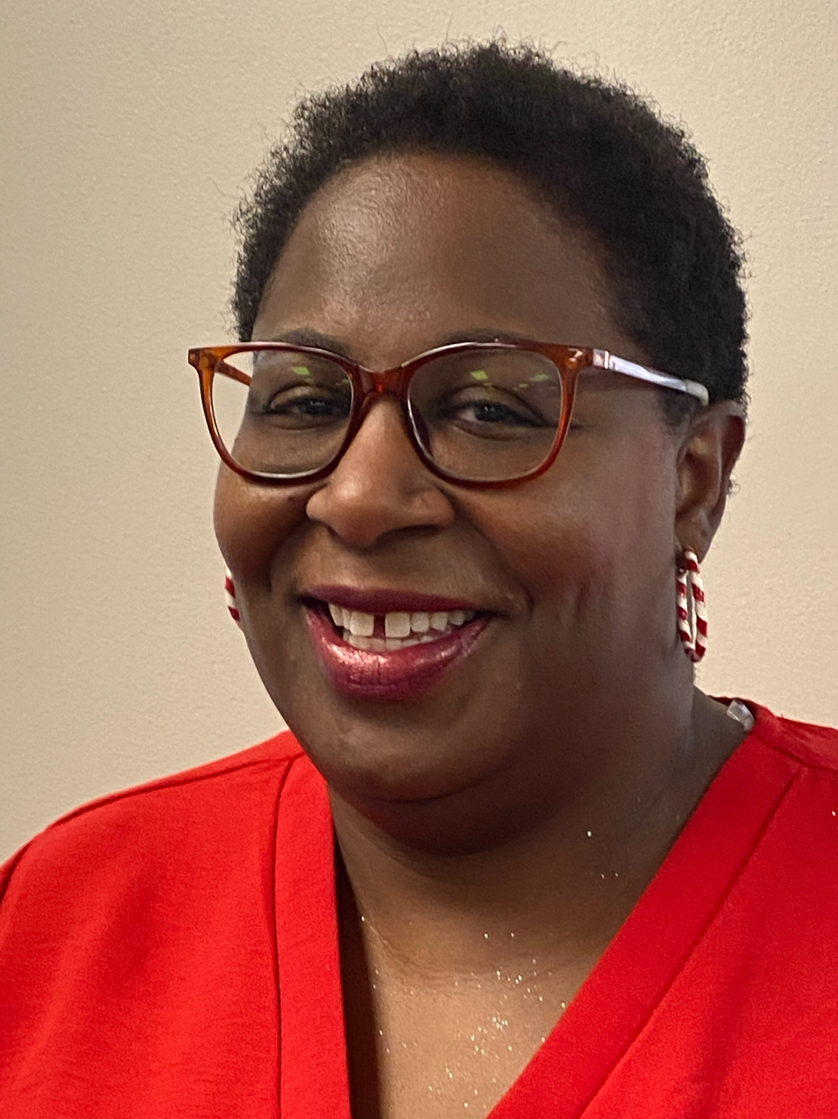
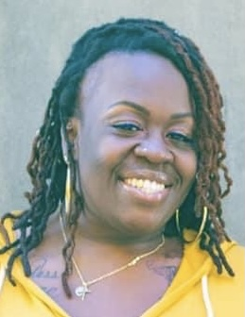
We are your District HEC CCHW We are a resource for our partners.
Olunda K. Hunt
OlHunt@health.in.gov
Blackford, Delaware, Fayette, Grant, Henry, Howard, Jay, Madison, Randolph, Rush, Tipton, Union, Wayne
District 6
District 7
CHW TBD
Vermillion, Parke, Putnam, Vigo, Clay, Owen, Sullivan, Greene
District 8
Samantha Daniels
Monroe, Brown, Bartholomew, Lawrence, Jackson, Orange, Washington
SaDaniels@health.in.gov

Slide 16
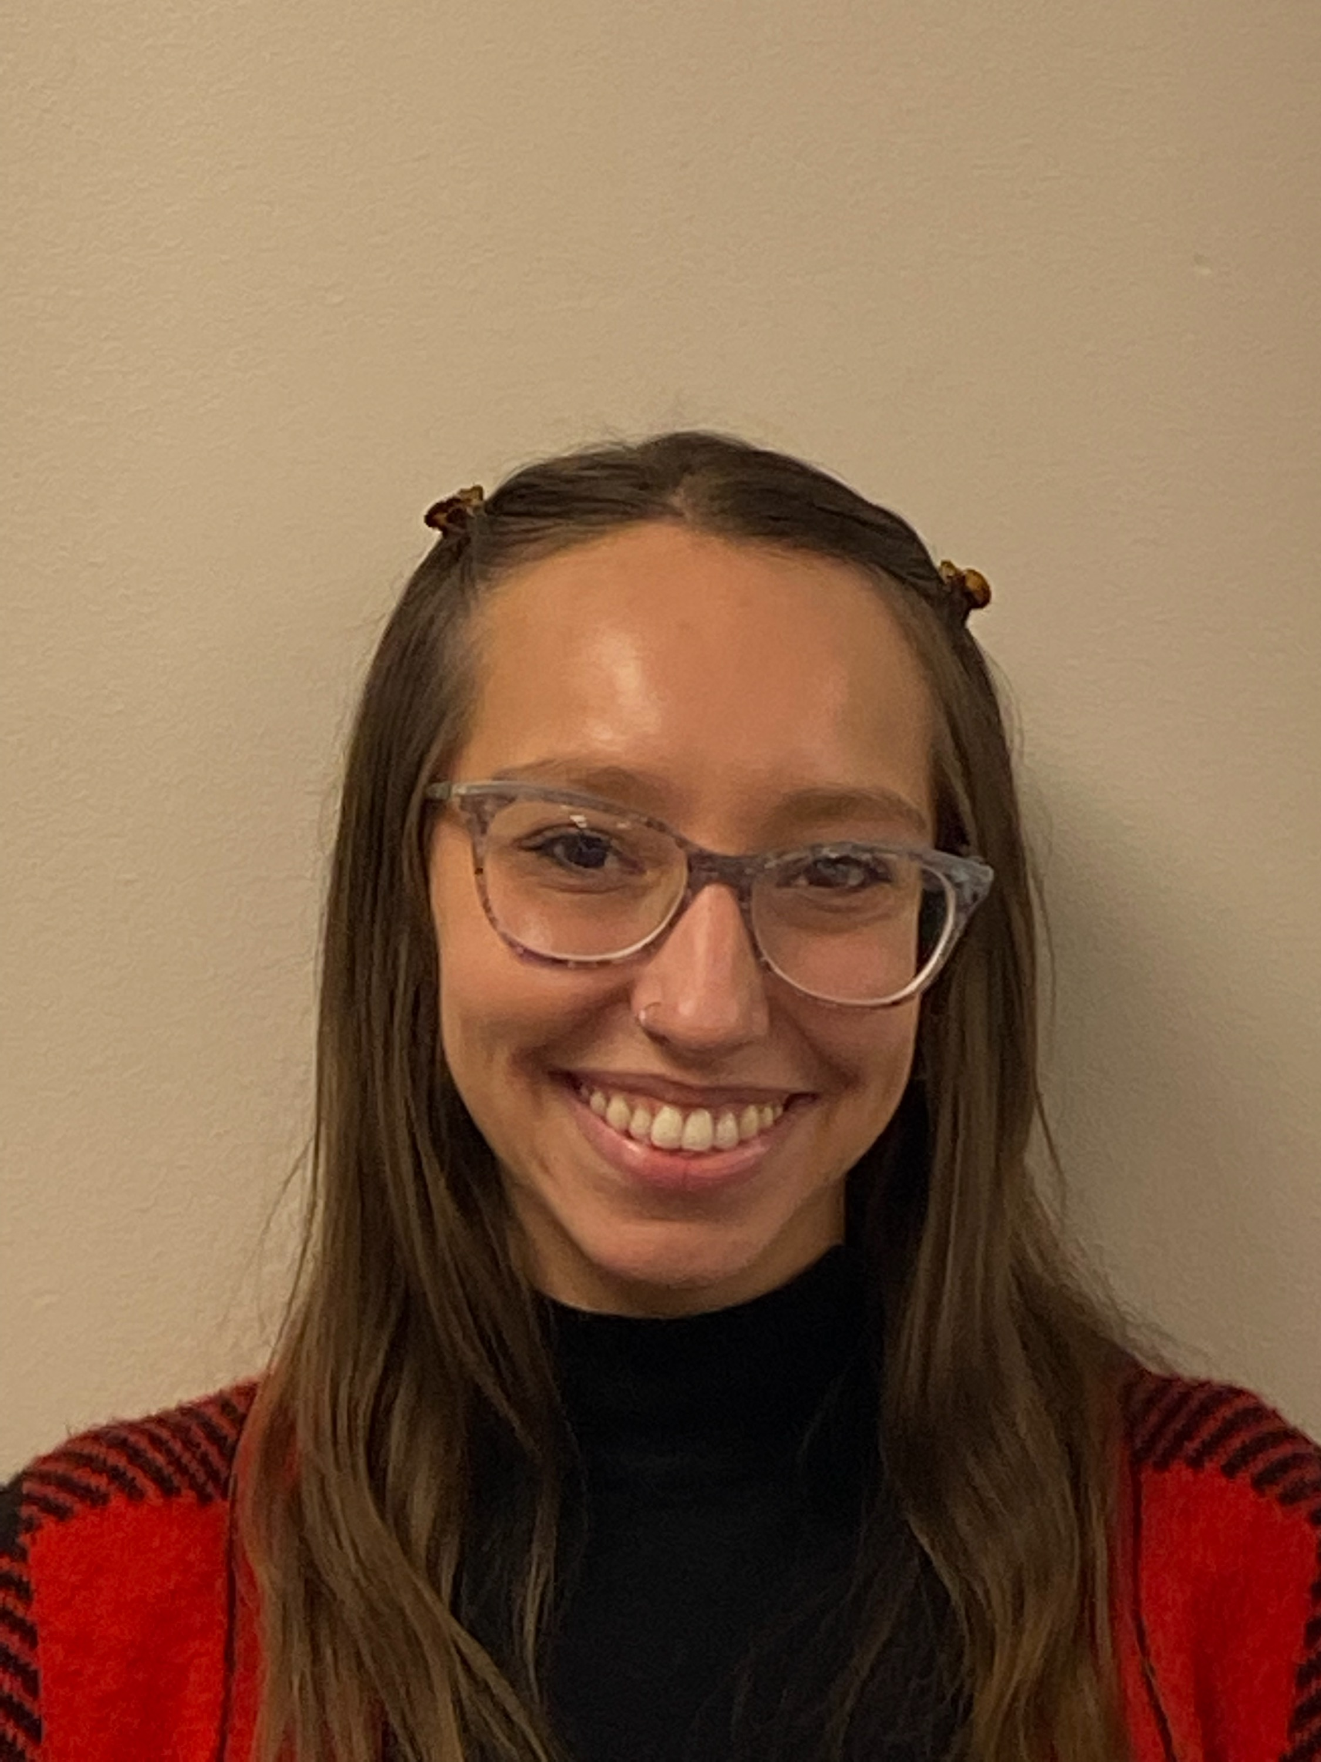
We are your District HEC CCHW We are a resource for our partners.
Olivia Zarate
Ozarate@health.in.gov
Decatur, Franklin, Jennings, Ripley, Dearborn, Scott, Jefferson, Switzerland, Clark, Floyd, Harrison
CHW TBD
Knox, Daviess, Martin, Gibson, Pike, Dubois, Crawford, Posey, Vanderburgh, Warrick, Spencer, Perry
District 10

Slide 17
IN HEC-CHW MODEL: Evaluation
Evaluation Lead Organization: Purdue University Community Health Workforce Development Institute (CHWDI)
Evaluation Lead: Dr. Omolola (Lola) Adeoye-Olatunde, PharmD, MS. CHWDI Co-Director, Center for Health Equity and Innovation. Indianapolis, IN "She goes by Lola, Dr. Lola, or Dr. AO :)"
Interim Lead: Dr. Ashley Meredith, PharmD, MPH, BCACP, BCPS, CDCES, FCCP. CHWDI Co-Director, Center for Health Equity and Innovation. Indianapolis, IN

Slide 18
Core CHWDI Evaluation Team
Dr. Lola Adeoye-Olatunde Lead
Dr. Kourtney Byrd Program Manager Research Associate
Dr. Megan Conklin Program Manager Health Equity Fellow
Azeez Aina Student Research Assistant
Maeve Companik Student Research Assistant
Becca Ziolkowski CHW Research Assistant
Dr. Ashley Meredith Interim Lead

Slide 19
The uniqueness of our evaluation approach is that HECHWs and CHW council members will be trained to participate in research and evaluation activities!
Specific evaluation plans are evolving, and the Purdue Evaluation Team will work alongside District HECHWs and District Council Members to inform and execute these plans.
COMING SOON!
Be on the lookout for a more detailed virtual research overview presentation and Q&A by the CHWDI Evaluation Team.

Slide 20
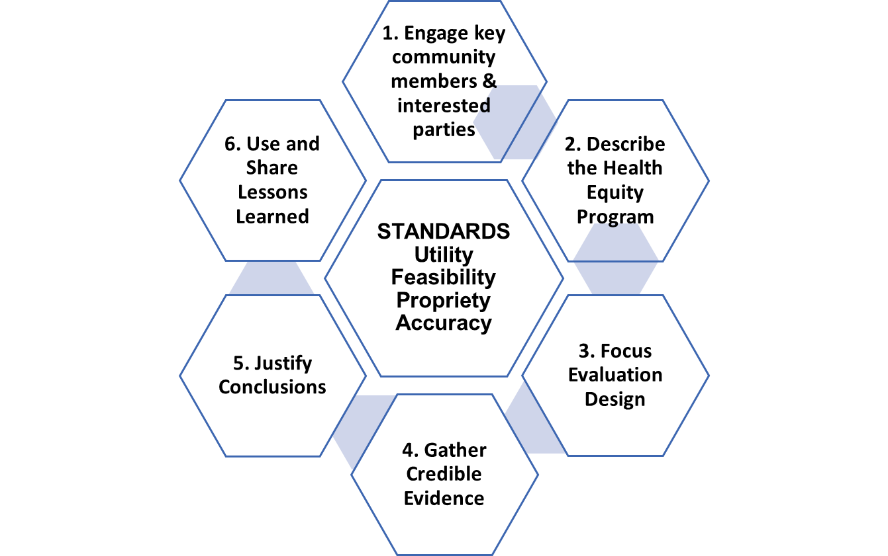
Evaluation
Goal: Describe the implementation, reach, and COVID-19-related SDOH outcomes of the IN HEC CHW Model among health disparity populations.
Evaluation will be guided by the "IDOH-OMH Adapted CDC Program Evaluation Framework: For Community-engaged Health Equity Programs," utilizing appropriate methods to measure outcomes of interest.
Notes:
We want to look at how partner engage. Why would we do that? It has to make sense to the community, how will we teach it to the community, is there credible evidence, we need to make sure it is ethical.

Slide 21
So, what do implementation and evaluation look like for the IN HEC CHW Model?

Slide 22
The IN HEC CHW Model: Cycle and Evaluation Approach. *Color coding indicates cycle steps aligned to evaluation steps.
IN HEC CHW Model Cycle
1. District Health Equity CHWs (HECHWs) Gather Resources: Identify community partners and resources
IN HEC CHW Model Evaluation Framework
2. HECHWs Make Connections: Cultivate partnerships
7. Share Outcomes and Develop Pivot Points: HECHWs conduct "lessons learned" council focus groups >> future strategies to better achieve goals
STANDARDS Utility Feasibility Propriety Accuracy
1. Engage council members
2. Define 9-month district action plan (DAP)
3. Focus DAP & evaluation design
4. Deploy plan & collect data
5. Evaluate -- justify conclusions
6. Ensure use, share lessons learned
At this step!
6. Evaluation: Summarize and compare outcomes to goals
3. HECHWs convene councils and conduct focus groups with district council members to identify ideas for DAP.
5. Deploy 9-Month DAP & Collect Data
4. Councils review and revise Purdue evaluation team's findings and create 9-Month DAP: Develop based on initial focus group findings.

Slide 23
Sharing plans to make a sustainable change with these key elements:
Goal: Provide evaluation findings & highlight program processes
Why: Sustainability and recognition as a statewide CHW-led model for promoting health equity
Audience: District councils, key partners, community members, and scientific and public health sectors @ state, regional, and local conferences and gatherings
How: Share key findings and stories in a manner that can be utilized (process, metrics, challenges, overcoming barriers and successes in promoting health equity) through infographics, policy reports, presentations, 1-pagers, and peer-reviewed manuscripts
Notes:
What is sustainable, how the community can engage and how we will share the findings. We want a unified voice, discover how the community can help themselves. How the community can work together.

Slide 24
Indiana (IN) Health Equity Council (HEC) Community Health Worker (CHW) Model
If you have any questions, please contact Ms. Shamika Crowder at:
scrowder@health.in.gov

